Slide 1

Noise Pollution (Regulation and Control) Rules, 2000
Information Security Fundamentals | Environmental Laws and Regulation
Course: Information Security Fundamentals | Chapter: Environmental Laws and Regulation | Bachelor of Engineering
DISCOVER · LEARN · EMPOWER
Notes:
Welcome everyone to this advanced session on Environmental Laws. Today we dive deep into the Noise Pollution (Regulation and Control) Rules, 2000. This is a critical component of our regulatory framework for sustainable development. Let us explore how these rules secure our planet through legal mechanisms.

Slide 2
Course Outcomes
SLIDE 2 / 14
Course Outcome
CO | BT LEVEL | DESCRIPTION
CO1 | BT4 | Recall, analyze and respond on fundamental environmental principles, such as ecological relationships and conservation strategies
CO2 | BT4 | Understand and analyze the interconnections between human activities and environmental impacts across different ecosystems
CO3 | BT4 | Understand and analyze and apply environmental laws and policies to analyse and propose solutions for real-world environmental challenges.
CO4 | BT2 | Students will analyse data from environmental monitoring programs to assess trends and predict future impacts on ecosystems.
CO5 | BT6 | Interpret, elaborate and propose various tools, design and innovative strategies for sustainable development and environmental conservation initiatives in securing the planet.
Chandigarh University
2 / 14
Notes:
Our primary focus for this lecture is Course Outcome 5. This outcome requires you to interpret and propose strategies for environmental conservation. We will see how noise regulations are a vital tool for securing the planet. You must understand the legal framework to propose effective conservation strategies.

Slide 3
Learning Objectives
SLIDE 3 / 14
Learning Outcomes
1
Analyze the legal framework established by the Noise Pollution Rules, 2000.
2
Evaluate the classification of areas based on permissible noise limits.
3
Calculate the permissible noise levels for specific industrial zones.
4
Critique the enforcement mechanisms and penalties for non-compliance.
5
Propose strategies for noise control in urban and industrial settings.
Chandigarh University
3 / 14
Notes:
By the end of this session, you will analyze the 2000 Rules thoroughly. You will evaluate how areas are classified into silence, residential, commercial, and industrial zones. We will also calculate permissible limits and critique enforcement. Finally, you will propose practical strategies for noise control.

Slide 4
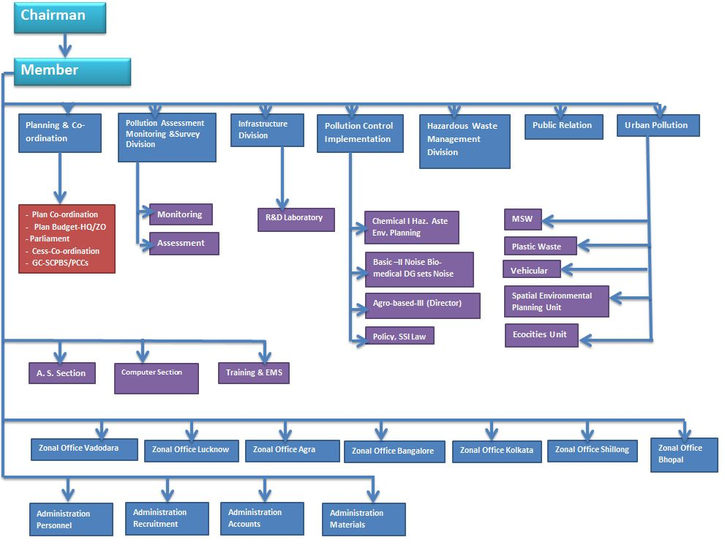
Lecture
SLIDE 4 / 14
Legal Framework and Objectives
1
The Rules were notified under the Environment Protection Act, 1986.
2
They aim to regulate noise generation and propagation in India.
3
The primary goal is to control noise pollution from all sources.
4
The rules apply to all areas including industrial, commercial, and residential zones.
5
They establish specific decibel limits for day and night time periods.
6
The Central Pollution Control Board oversees the implementation of these rules.
7
State Pollution Control Boards are responsible for local enforcement and monitoring.
File:Organizational structure of CPCB.jpg - Wikimedia Commons
Chandigarh University
4 / 14
Notes:
These Rules were notified under the Environment Protection Act of 1986. Their main goal is to regulate noise from all sources effectively. They apply universally across industrial, commercial, and residential zones. The Central Pollution Control Board oversees implementation while State Boards handle local enforcement.

Slide 5
Lecture
SLIDE 5 / 14
Classification of Areas
1
Silence Zones are areas within 100 meters of hospitals and schools.
2
Residential areas have lower noise limits compared to commercial zones.
3
Commercial areas allow higher noise levels due to business activities.
4
Industrial areas permit the highest noise levels among all categories.
5
The classification determines the permissible decibel limits for each zone.
6
Silence zones are strictly prohibited from any commercial noise generation.
7
The classification ensures that sensitive areas remain protected from disturbance.
Chandigarh University
5 / 14
Notes:
The rules classify areas into four distinct categories for regulation. Silence zones are strictly defined as 100 meters around hospitals and schools. Residential areas have lower limits than commercial or industrial zones. This classification ensures sensitive areas remain protected from excessive noise disturbance.

Slide 6
Lecture
SLIDE 6 / 14
Permissible Noise Limits
1
Silence zones allow a maximum of 50 dB during the day.
2
Silence zones allow a maximum of 40 dB during the night.
3
Residential areas permit 55 dB during the day and 45 dB at night.
4
Commercial areas permit 65 dB during the day and 55 dB at night.
5
Industrial areas permit 75 dB during the day and 70 dB at night.
6
Daytime is defined as 6:00 AM to 10:00 PM for all zones.
7
Nighttime is defined as 10:00 PM to 6:00 AM for all zones.
Chandigarh University
6 / 14
Notes:
Let us look at the specific permissible limits for each zone. Silence zones allow only 50 dB during the day and 40 dB at night. Residential areas permit 55 dB by day and 45 dB by night. Commercial and industrial zones have progressively higher limits to accommodate their activities.

Slide 7
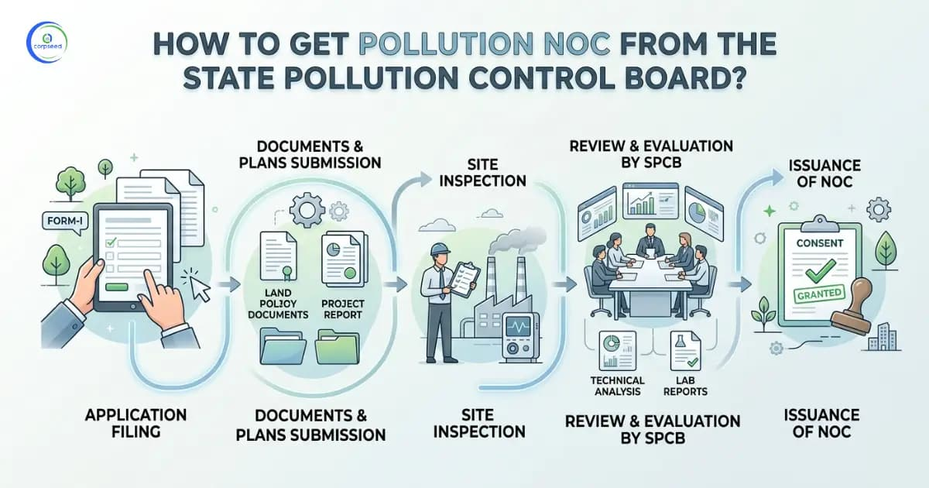
Lecture
SLIDE 7 / 14
Sources of Noise Pollution
1
Industrial machinery and manufacturing processes are major noise generators.
2
Transportation including vehicles, trains, and aircraft contributes significantly to noise.
3
Construction activities generate high noise levels during day and night.
4
Social events and loudspeakers are common sources of community noise.
5
Firecrackers and fireworks create sudden, high-intensity noise spikes.
6
The rules specifically regulate loudspeakers and public address systems.
7
All sources must adhere to the zone-specific limits strictly.
The Noise Pollution (Regulation and Control) Rules, 2000 (source: www.corpseed.com)
Chandigarh University
7 / 14
Notes:
Noise pollution arises from various sources including industry and transportation. Construction activities and social events are also significant contributors. The rules specifically regulate loudspeakers and public address systems to control community noise. All sources must adhere to the zone-specific limits strictly.

Slide 8
Lecture
SLIDE 8 / 14
Regulation of Loudspeakers
1
Loudspeakers cannot be used in silence zones under any circumstances.
2
Public address systems require prior permission from local authorities.
3
The use of loudspeakers is prohibited after 10:00 PM in all zones.
4
Volume levels must not exceed the permissible limits for the zone.
5
Unauthorized use of loudspeakers attracts penalties and legal action.
6
The rules aim to prevent disturbance during night hours specifically.
7
Local authorities have the power to seize equipment violating these rules.
Chandigarh University
8 / 14
Notes:
The rules strictly regulate the use of loudspeakers and public address systems. They cannot be used in silence zones under any circumstances. Use is prohibited after 10:00 PM in all zones to prevent disturbance. Local authorities have the power to seize equipment violating these rules.

Slide 9
Lecture
SLIDE 9 / 14
Regulation of Firecrackers
1
Firecrackers are prohibited in silence zones completely.
2
Use of firecrackers is restricted to specific hours in other zones.
3
The rules aim to reduce sudden high-intensity noise spikes.
4
Violations of firecracker rules attract penalties and fines.
5
The Supreme Court has issued specific guidelines on firecracker usage.
6
Noise levels from firecrackers must not exceed 125 dB.
7
Local authorities enforce these restrictions during festivals and events.
The Noise Pollution (Regulation and Control) Rules, 2000 (source: www.corpseed.com)
Chandigarh University
9 / 14
Notes:
Firecrackers are a major source of sudden noise spikes. They are prohibited in silence zones completely. Their use is restricted to specific hours in other zones. The rules aim to reduce these spikes and protect public health.

Slide 10
Lecture
SLIDE 10 / 14
Worked Numerical Example
GOVERNING EQUATION
Excess noise = Measured level - Permissible limit
SCENARIO
A factory in an Industrial zone operates at 78 dB.
CALCULATION
78 dB - 75 dB = 3 dB excess noise.
• Daytime limit for Industrial zones is 75 dB.
• The factory exceeds the limit by 3 dB during daytime.
• This violation requires immediate corrective action to reduce noise.
• Penalties apply for continuous non-compliance with the established limits.
Chandigarh University
10 / 14
Notes:
Consider a factory in an industrial zone operating at 78 dB. The daytime limit for industrial areas is 75 dB. The excess noise is calculated as 78 minus 75, which equals 3 dB. This violation requires immediate corrective action to reduce noise levels.

Slide 11

Lecture
SLIDE 11 / 14
Enforcement and Penalties
1
Violation of noise limits is a criminal offense under the rules.
2
Penalties include imprisonment for up to five years for repeat offenders.
3
Fines are imposed for first-time violations of noise regulations.
4
The police and local authorities are empowered to enforce these rules.
5
Repeat offenders face stricter penalties including imprisonment.
6
The rules provide for seizure of equipment causing excessive noise.
7
Legal action is taken against individuals and organizations violating the rules.
Source: static.vecteezy.com
Chandigarh University
11 / 14
Notes:
Violations of noise limits are considered criminal offenses under these rules. Penalties include imprisonment for up to five years for repeat offenders. Fines are imposed for first-time violations of noise regulations. The police and local authorities are empowered to enforce these rules.

Slide 12
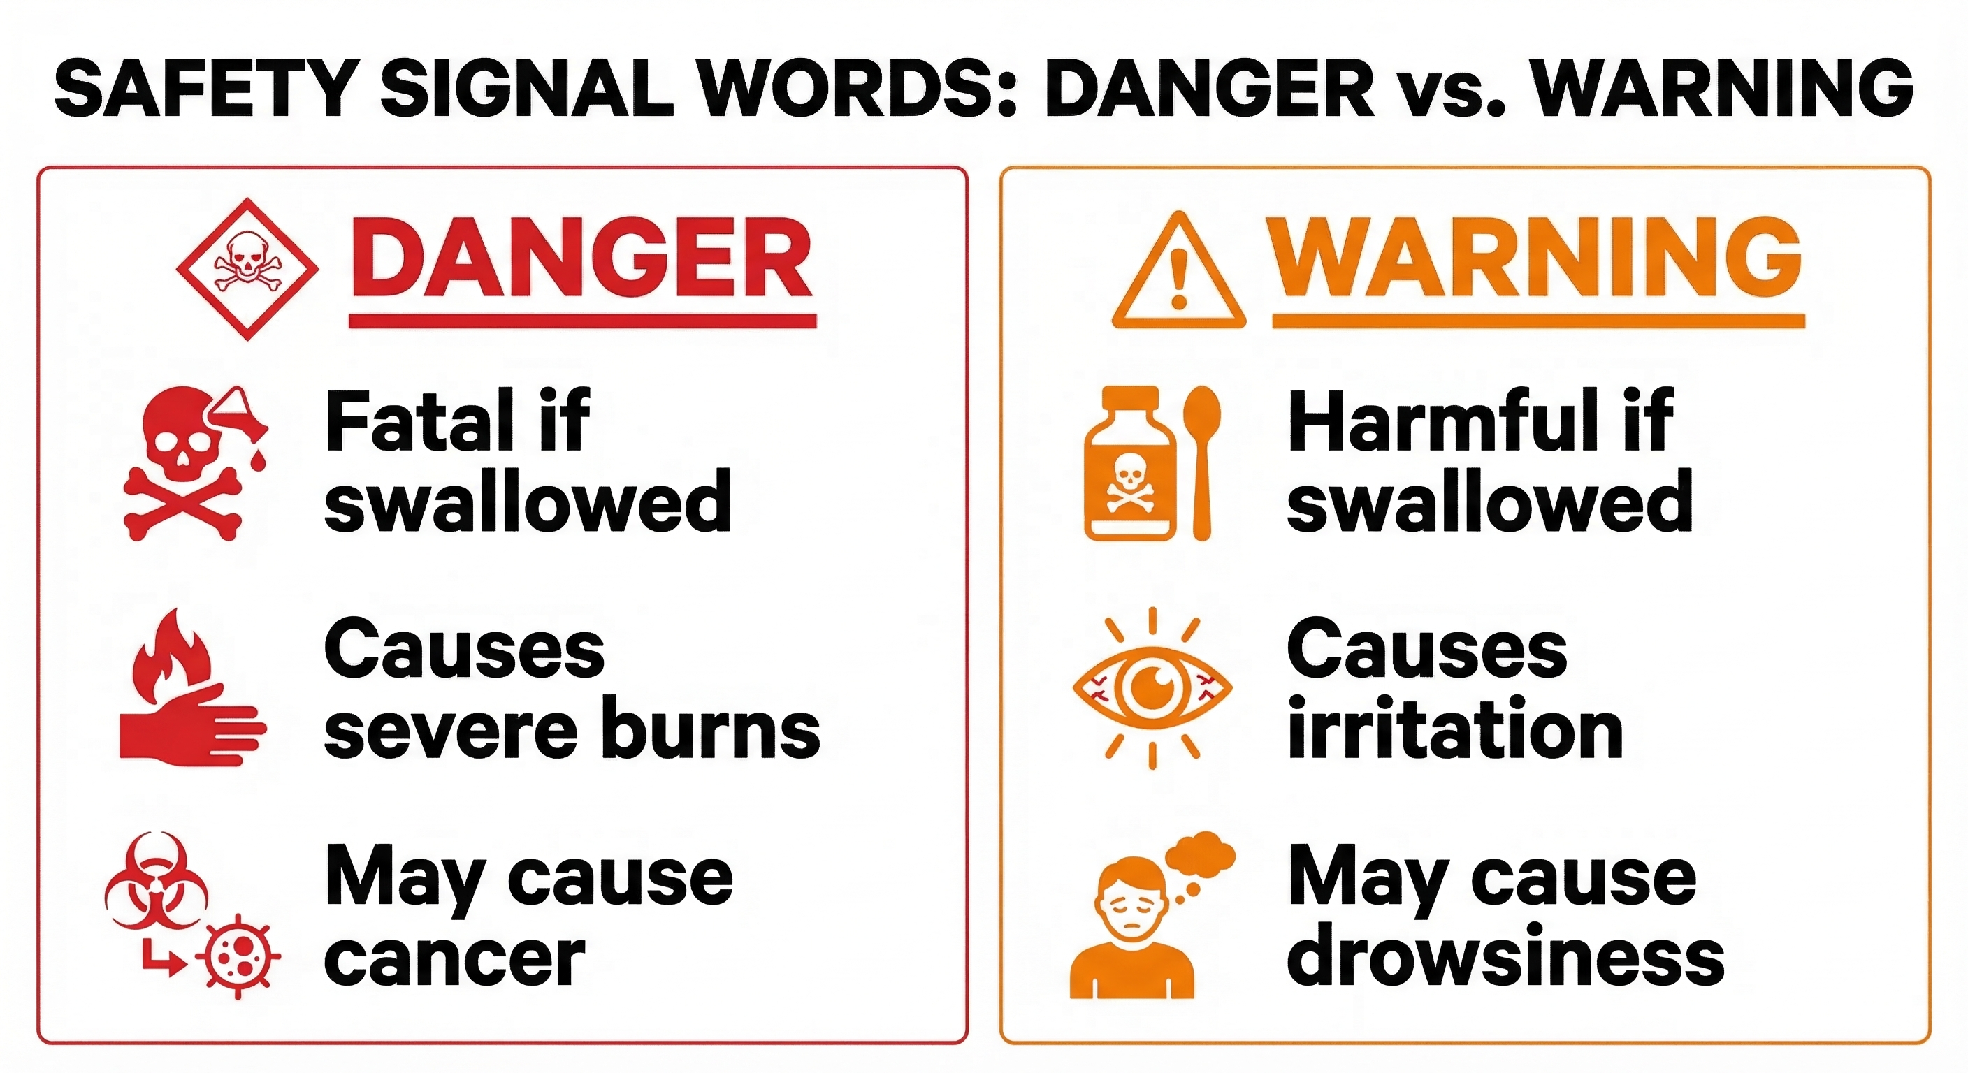
Lecture
SLIDE 12 / 14
Common Pitfalls in Compliance
1
Ignoring the distinction between day and night time periods.
2
Assuming commercial zones have the same limits as residential areas.
3
Failing to obtain prior permission for loudspeaker usage.
4
Underestimating the impact of construction noise on nearby zones.
5
Not monitoring noise levels regularly for compliance verification.
6
Confusing silence zone boundaries with general residential areas.
7
Neglecting the specific restrictions on firecracker usage ×.
Source: www.safetyevolution.com
Chandigarh University
12 / 14
Notes:
A common pitfall is ignoring the distinction between day and night time periods. Another mistake is assuming commercial zones have the same limits as residential areas. Failing to obtain prior permission for loudspeaker usage is also frequent. Not monitoring noise levels regularly leads to non-compliance.

Slide 13
Lecture
SLIDE 13 / 14
Key Takeaways
1
The Noise Pollution Rules, 2000 regulate noise from all sources.
2
Areas are classified into Silence, Residential, Commercial, and Industrial zones.
3
Permissible limits vary by zone and time of day.
4
Loudspeakers and firecrackers are strictly regulated to prevent disturbance.
5
Violations attract penalties including fines and imprisonment.
Chandigarh University
13 / 14
Notes:
To summarize, the Noise Pollution Rules, 2000 regulate noise from all sources. Areas are classified into four distinct zones with varying limits. Loudspeakers and firecrackers are strictly regulated to prevent disturbance. Violations attract penalties including fines and imprisonment.

Slide 14
Lecture
SLIDE 14 / 14
References
ENVIRONMENTAL STUDIES
From Crisis to Cure — R. Rajagopalan
• Environmental Science and Engineering — Benny Joseph
• Environmental Studies — R.C. Sharma and D. Gurbir Sangha
• Introduction to Environmental Science — Anjaneyulu, Y.
• Environmental Pollution Control Engineering — C.S. Rao
• Textbook of Environmental Studies for undergraduate courses — E. Bharucha
• Environmental Science — S.C. Santra
Chandigarh University
14 / 14
Notes:
These references provide comprehensive coverage of environmental laws and regulations. They are essential for understanding the legal framework and its application. Please consult these texts for further study on environmental conservation. Thank you for your attention.

